Slide 1

LSDesign
Design and Make Project
Group Members : Ritesh Hans, 220893
Gottupulla Venkata Aman,
Dhananjay Dixit,
Yash Kumar Meena,
Himanshu Yadav,
LSDesign

Slide 2
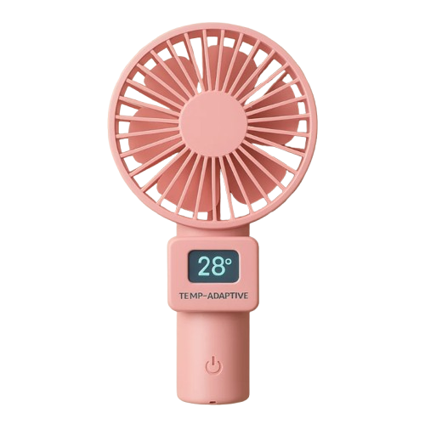
Smarter Cooling for Hot Days
Temperature-Adaptive USB Fans
LSDesign

Slide 3



The Problem: Inefficient Cooling
Rising Summer Heat
Constant Fan Speed
Lack of Comfort
Extreme heat waves are becoming more frequent and intense.
Traditional USB fans operate at a fixed speed, wasting energy.
No temperature adjustment for optimal personal comfort.
Our Solution: Adaptive Cooling
Temperature-Based Adjustment
Temperature Sensor
Maintains Portability
Embedded to read the ambient temperature.
Compact and easy to use, just like a standard USB fan.
Fan speed automatically adjusts to the surrounding temperature.
LSDesign

Slide 4
Design Evaluation & Justification
We are considering the following improvement directions before choosing this one:
Idea | Benefits | Drawbacks
USB Fan with Cooling Gel Inserts | Temporary relief, passive cooling | Bulky, messy, not reusable, not feasible
Solar-powered USB Fan | Eco-friendly, uses sunlight | Not usable indoors/night, not feasible
Temperature-controlled USB Fan | Energy saving, user comfort, responsive | Slight increase in circuit complexity
Selected Idea - Temperature-controlled fan, offers high impact for low cost and technical feasibility
Reason – The only financially feasible option, that would not increase the price of the product significantly and saves energy
LSDesign

Slide 5

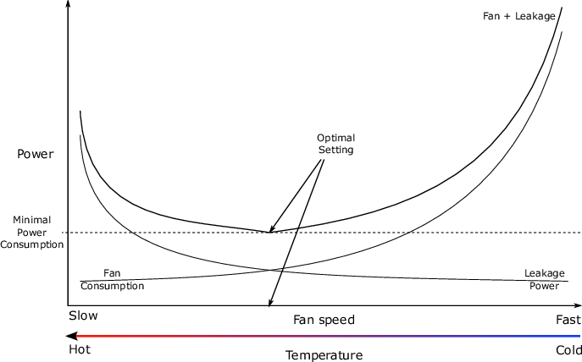


How It Works: Temperature Control
Temperature Sensor
Sensor accurately reads the surrounding temperature.
Microcontroller
Adjusts the fan speed by changing the PWM signal.
Fan Motor
Fan speed increases in heat and decreases in cooler conditions.
LSDesign

Slide 6
BOM (Bills of Material)
Component | Function | Material | Process | Qty | Notes
Fan Blade | Airflow | Polypropylene | Injection molded | 1 | Flimsy
Motor | Spins blade | Copper/metal | Assembled unit | 1 | 5V DC motor
USB Cable | Power input | PVC + copper | Extrusion | 1 | Reusable
Arduino Uno | Control system | PCB + plastic | Assembled | 1 | External chip
DST Temp Sensor | Temp sensing | PCB + metal | Assembled | 1 | DHT11 or similar
LSDesign

Slide 7
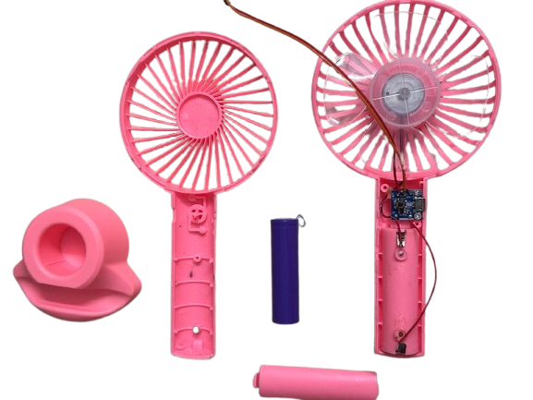
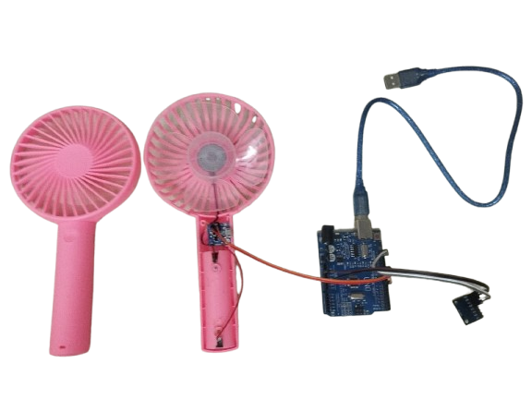
Prototype Showcase
Modified Components
Temperature sensor added
Microcontroller integrated
PWM circuit implemented
The prototype showcases the integration of a temperature sensor and a microcontroller into a standard USB fan. These modifications enable the fan to adapt its speed based on the ambient temperature. At 25°C, the fan runs at low speed. Above 30°C, speed ramps up linearly.
LSDesign

Slide 8





Key Benefits: Comfort and Efficiency
Adaptive Comfort
Rechargeable Battery
Reduced Noise
Eco-Friendly
No more reaching for the switch – automatic speed scaling enhances convenience.
Optional – can add a 18650 battery for off-grid operation.
Runs quieter at lower speeds when temperature is lower – great for night use.
Lowers average energy use by 30–40% compared to always-on fans.

Slide 9



Future Innovations
2
App Control
1
Humidity Sensing
Solar Charging
3
LSDesign

Slide 10
Thank You !
LSDesign

